Slide 1

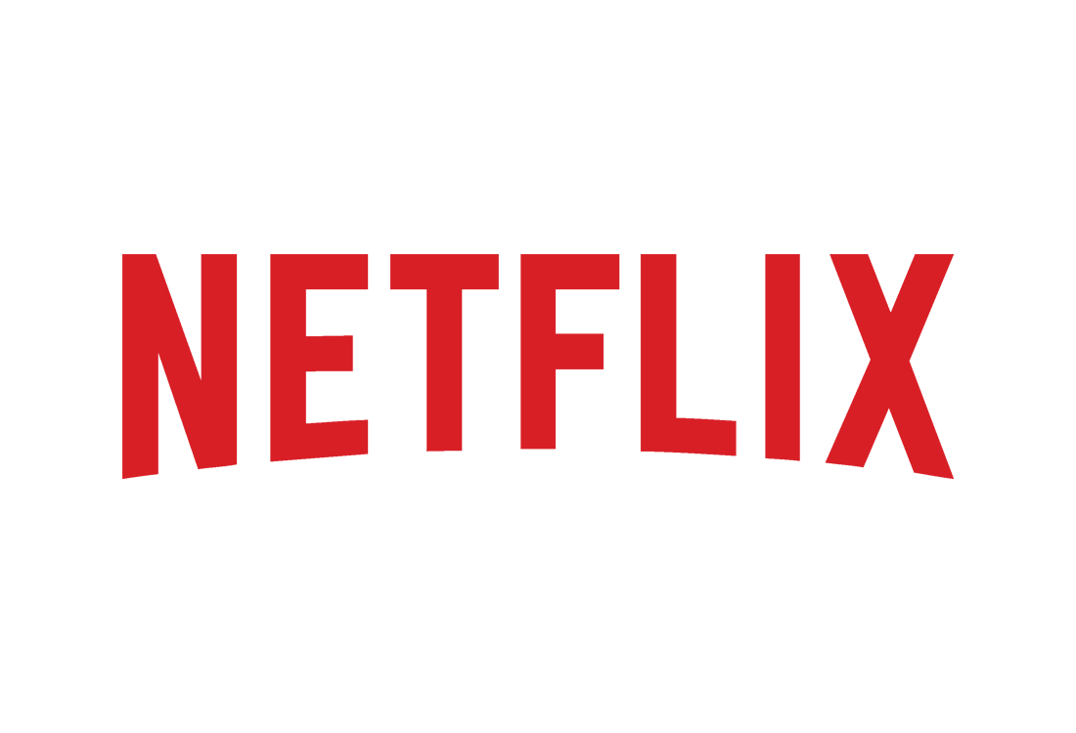
Netflix Data
Analysis

Slide 2
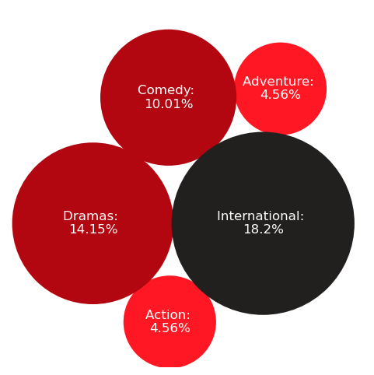
Data Summary
TV-MA
Most Popular Film Rating
Top Genres
4989
Number of Directors
36415
Number of Cast
And 34 others
Year 1925
Oldest Released TV Show
Average IMDB Score
1.6
5.93
8.9
3/11

Slide 3
Business Case
“
If Netflix consistently hosts high IMDB rating movies/tv-shows on their platform, they are likely to attract more viewers.
”
4/11

Slide 4
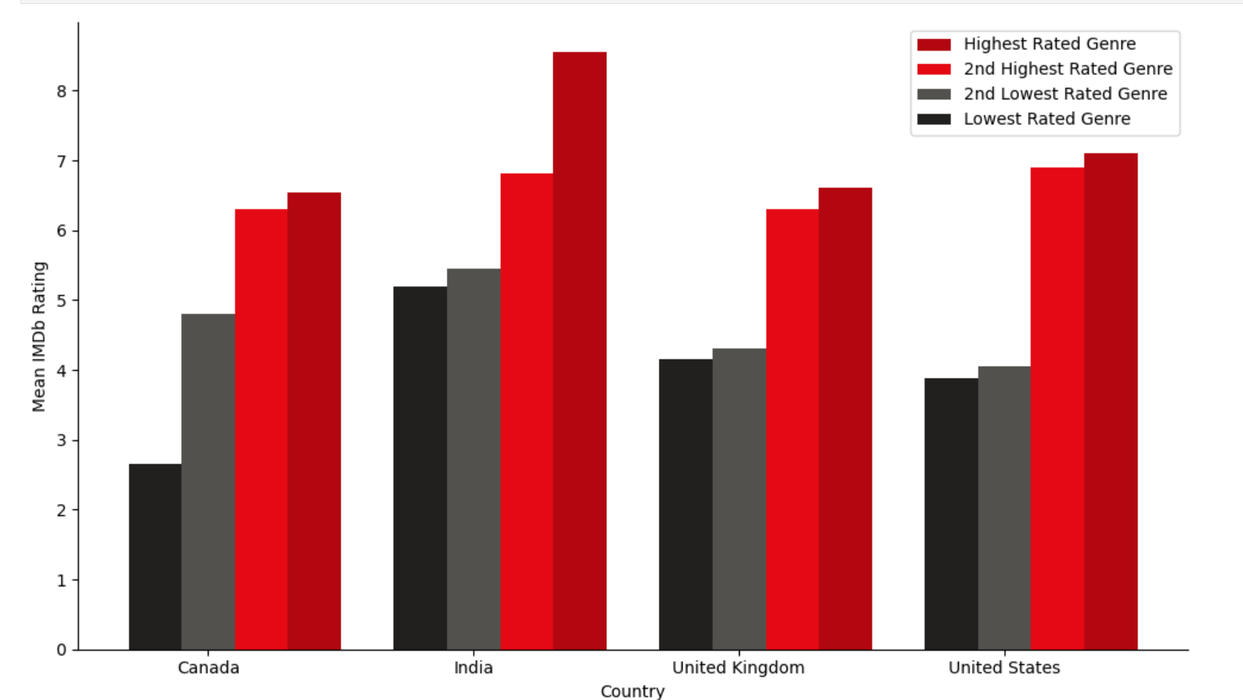
Highest and Lowest Rated Movie Genres by Country
Different countries are better at producing movies of certain genres
Drama is highest rated in Canada and UK whereas Biography is highest rated in US and India.
Biography
Animation
Biography
Thriller
Drama
Sport
Horror
Drama
Drama
Family
Horror
Thriller
Horror
Family
Action
Western
5/11

Slide 5
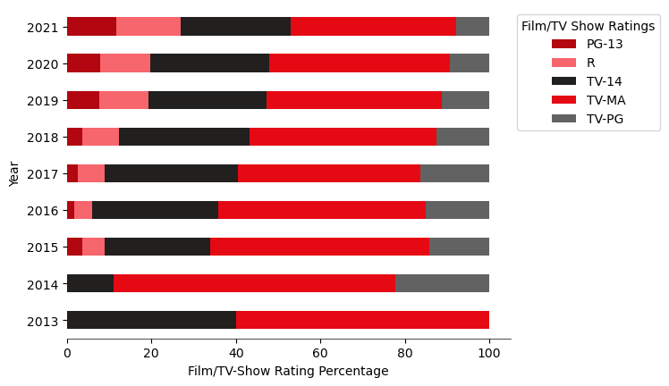
Recent years trend for top Film/TV-Show ratings on Netflix
PG-13 & R content is increasing in recent years while TV-PG is on a decline
IMDB Rating: 6.17
IMDB Rating: 6.01
IMDB Rating: 6.04
IMDB Rating: 5.75
IMDB Rating: 6.06
Netflix is on the right path. They are increasing high IMDB Rating content over the years.
6/11
Notes:
=correct labels, *100

Slide 6
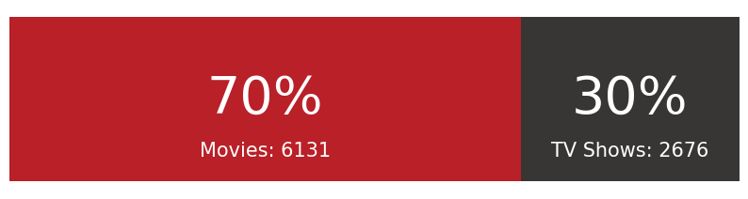
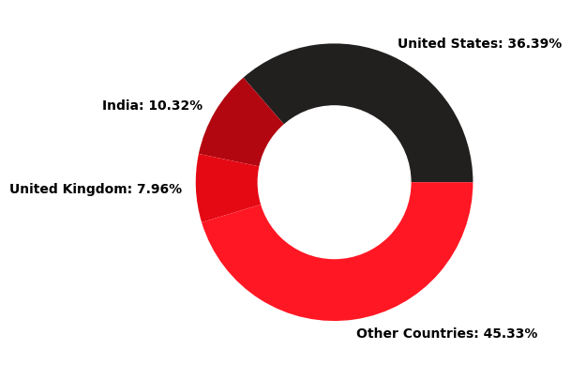
Data Summary
Movie and TV Show distribution
98 Minutes
Average Movie Duration
1 Season
Average TV Show Duration
Grey's Anatomy
Longest TV Show
Total Countries:
121
2/11

Slide 7
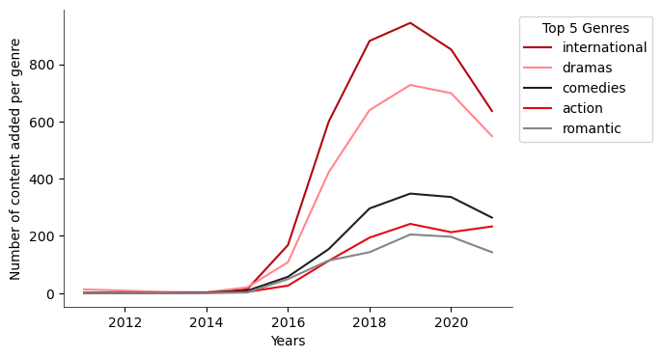
Recent years trend for top genres on Netflix
International Movies, Drama and Comedy are among the popular genres
IMDB Rating: 6.07
IMDB Rating: 6.23
IMDB Rating: 5.89
IMDB Rating: 5.87
IMDB Rating: 5.92
Netflix is on the right path. They are increasing high IMDB Rating genre content over the years.
7/11

Slide 8
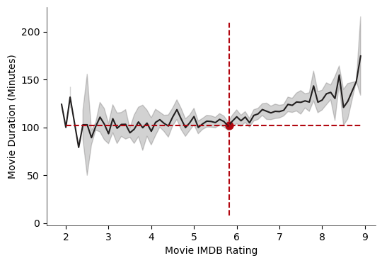
Relation between Movie Duration and Rating across top 3 countries
Movie duration tend to correlate positively with IMDB movie ratings
Longer Duration Movies tend to get higher IMDB Rating.
Mean Duration and Mean IMDB Rating
8/11

Slide 9
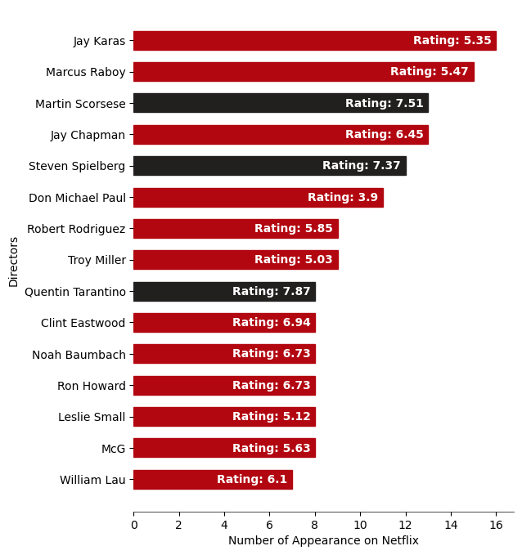
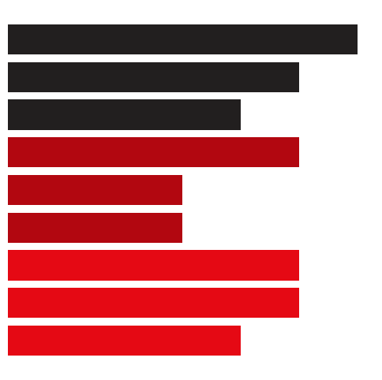
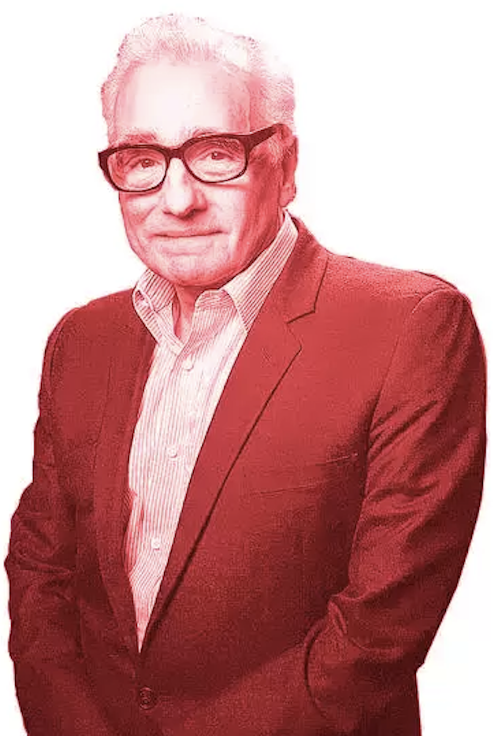
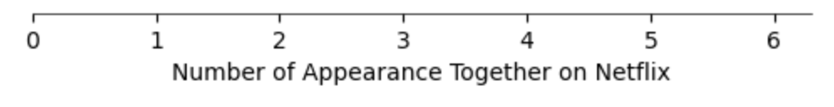
Most appearing directors and their performance
Some less frequent directors give higher rating content
Top 15 Directors
Director’s Top Favorite Cast
Samuel L Jackson
Martin Scorsese
Michael Madsen
Uma Thurman
Harrison Ford
Steven
Spielberg
Karen Allen
Denholm Elliott
Robert De Niro
Quentin
Tarantino
Harvey Keitel
Leonardo DiCaprio
Martin Scorsese
Netflix should bring more content in USA from Martin Scorsese, Steven Spielberg and Quentin Tarantino.
Pic Credits: Link
9/11

Slide 10


Comparison between description of lower and higher rated movies
‘Crime’ themed movies tend to have higher ratings than ‘family’ themed movies
Movies with IMDB Rating >= 7
Movies with IMDB Rating <= 5
Netflix should host more ‘Crime’ themed movies to boost their average IMDB ratings.
10/11

Slide 11




Thank you for watching!
11/11

